Slide 1
Whatever you are, be a good one.
– Abraham Lincoln
Lecture 13 – Breadth-First Search
CST370 – Design & Analysis of Algorithms
Dr. Byun
Computer Science

Slide 2
Lecture Objectives
After completion of this lecture, you will be able to
  perform the breadth-first search (BFS) to visit all vertices of a graph using a queue.

Slide 3
Breadth-First Search (BFS) Algorithm
To get the basic idea of BFS, watch this video.
  http://y2u.be/QRq6p9s8NVg
  Note that BFS uses a queue for its operation.

Slide 4
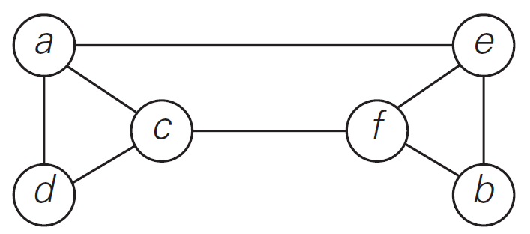
BFS Example (1 of 2)
Watch this video to understand the detailed operation of BFS for the graph below.
  http://y2u.be/-n-nyIVyUWA

Slide 5
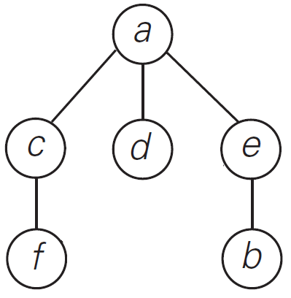
BFS Example (2 of 2)
Sequence of vertices visited
  a → c → d → e → f → b
BFS tree with “tree edges”.

Slide 6
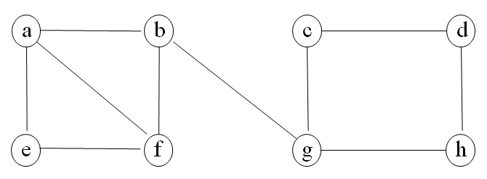
Exercise
Starting at the vertex a, conducting the BFS algorithm for the graph below.
  Then, present the result of mark array and draw a BFS tree.

Slide 7
Solution
Queue:
a
b
c
d
e
f
g
h
Mark Array

Slide 8
BFS – Time Efficiency
The time efficiency of the BFS algorithm is similar to the DFS algorithm.
It depends on the data structure used to represent the graph.
  For the adjacency matrix representation, the traversal time is in Θ(|V|²).
  For the adjacency list representation, it is in Θ(|V| + |E|) where |V| and |E| are the number of the graph’s vertices and edges, respectively.

Slide 9
Applications of BFS
Same as DFS applications
  Checking connectivity
  Checking acyclicity of a graph
  Finding connectivity components
  etc.
We can also find paths from a vertex to all other vertices with the smallest number of edges.

Slide 10
BFS Implementation in C++
Go to
  https://repl.it/@YBYUN/BFS
Run the program with the following input graph data
      3
      2
      0 1
      1 2
  The program will run the BFS algorithm and display the mark array.

Slide 11
Input Graph Format
1st line: Number of vertices
2nd line: Number of edges
All following lines includes the edge data with a starting vertex and an ending vertex.
Example
    3
    3
    0 1
    0 2
    1 2
0
1
➔
2

Slide 12
A Vector of “Vectors”
In the source program, we use a vector of “vectors” to represent the graph.
Example
  vector<vector<int>> graph;
Reference
  https://www.geeksforgeeks.org/2d-vector-in-cpp-with-user-defined-size/

Slide 13
Source Code (1 of 3)
int main()
{
vector<vector<int>> graph;
read_graph(graph);
printGraph(graph);
int src = 0;
bfs(graph, src);
return 0;
}

Slide 14
Source Code (2 of 3)
void read_graph(vector<vector<int>> & g) {
int num_of_vertices;
cin >> num_of_vertices;
// Adjust the size of graph vector to hold all vertices.
g.resize(num_of_vertices);
int num_of_edges;
cin >> num_of_edges;
int from, to;
for (int i = 0; i < num_of_edges; i++) {
cin >> from >> to;
g[from].push_back(to);
}
}

Slide 15
Source Code (3 of 3)
void bfs(vector<vector<int>> & g, int src) {
queue<int> q;
int count = 0;
vector<int> mark(g.size(), 0);
mark[src] = ++count;
q.push(src);
while (!q.empty()) {
int curr = q.front();
q.pop();
cout << "visiting: " << curr << endl;
for (int i = 0; i < g[curr].size(); i++) {
int neighbor = g[curr][i];
if(mark[neighbor] == 0) {
mark[neighbor] = ++count;
q.push(neighbor);
}
}
}
cout << "\n==== Mark Array ==== " << endl;
for (int i = 0; i < g.size(); i++)
cout << "Mark[" << i << "]: " << mark[i] << endl;
return;
}

Slide 16
Exercise
Instead of using a vector of “vectors” to represent the graph, can we use a vector of “lists”?
  How about a vector of “sets”?

